Slide 1
Connections
Samantha Holmes
McCormick
LA9
10 June 2014

Slide 2
Of Mice and Men By: John Steinbeck
Many people face isolation due to unrealistic societal pressures. In this story, many characters, including Lennie, Curley’s wife, and Crooks all face isolation
“The best laid schemes of mice and men often go awry”* (Burns)
*this quote is not from Of Mice and Men, but from a poem entitled, To a Mouse

Slide 3
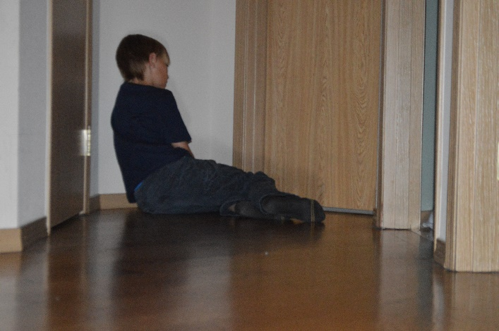
Of Mice and Men By: John Steinbeck
I’m not your hero:
“I was used to standing in the shadow[s]”
-Tegan & Sara
Isolation of Reality:
-Samantha Holmes

Slide 4
Of Mice and Men By: John Steinbeck
I’m not your hero:
“I was used to standing in the shadow[s]”
-Tegan & Sara
This story focuses on the reality of isolation, and how much it can affect people in their everyday life. The photo, taken by Samantha Holmes, shows a boy who suffers from social isolation. This relates to Of Mice and Men, because this girl faces life the same way that Curley’s wife did in the book. Similarly, the lyrics relate to the same theme, because they explain how a person was so used to being ignored, and not being acknowledged, that it became their norm. Isolation is a serious problem that many people suffer from.

Slide 5
Scarlet Ibis By: James Hurst
I’m not your hero:
“I was used to standing in the shadow[s]”
-Tegan & Sara
Throughout life, it is always important to help others, whenever possible. In this eventful story, the narrator acts as a role model, and always extends a helping hand to his dying brother, Doodle.
“All you have to do is try” (Hurst 338)

Slide 6
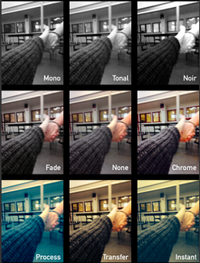
Scarlet Ibis By: James Hurst
Lean on Me
“Lean on me, when your not strong, and I’ll be your friend, I’ll help you carry on”
-Bill Withers
Helping Hands
-Samantha Holmes

Slide 7
Scarlet Ibis By: James Hurst
I’m not your hero:
“I was used to standing in the shadow[s]”
-Tegan & Sara
Even if you do not know what is going on in a person life, it is important to give them help- whenever possible. This is what the song, picture, and Scarlet Ibis, all tell us. Lean on me portrays the fact hat there are people out there who will always be willing to help, and The Scarlet Ibis also portrays this, but through the story of two brother instead. The picture ties this all together, as one person is helping another up, and is helping them out of hard times. A helping hand is always important.

Slide 8
Harrison Bergeron By: Kurt Vonnegut Jr.
I’m not your hero:
“I was used to standing in the shadow[s]”
-Tegan & Sara
In modern society, outsiders constantly face assimilation in order to fit into the “status quo”. In, Harrison Bergeron, by Kurt Vonnegut Jr. anyone who is smart, better looking, or strong, must live with ridiculous “handicaps” in order to make everyone seem “equal”.
“don’t care if we’re not equal” (Vonnegut 1)

Slide 9
Harrison Bergeron By: Kurt Vonnegut Jr.
I am Free
“Through You, the darkness flees. Through You, my heart screams”
-Peter Furler and Jonathan Christian Egan.
Don’t want to fit in
-Samantha Holmes

Slide 10
Harrison Bergeron By: Kurt Vonnegut Jr.
People are constantly being forced to change in order to fit into the status quo. As the main character in Harrison Bergeron experiences, it is very hard to be a “perfect mold” of a societal person, and everyone should get to be themselves. This is also what the quote from the song, I want to be free, tells us, because people should not be forced to fit into a particular mold, they should just get to be themselves. The picture Don’t want to fit in in portrays this same scenario, but in a more realistic manner. Nobody should have to change in order to fit into societies mold.

Slide 11
Animal Farm By: George Orwell
In the hands of some people, power quickly becomes corruption. In, Animal Farm, by George Orwell, Napoleon's power, granted to him by the other animals, quickly corrupts him and those closest to him. This forces the other animals to suffer under rough conditions, and makes it very difficult to thrive.
““all animals are equal, but some...are more equal than others” (Orwell 134)”

Slide 12
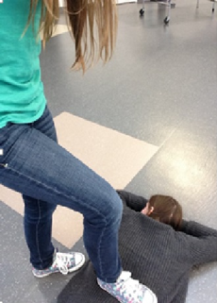
Animal Farm By: George Orwell
Power and Corruption:
“You're supposed to care about your people But you only care about yourself”
-D.O.B
Overruling the weak:
-Samantha Holmes

Slide 13
Animal Farm By: George Orwell
In the hands of some people, power will quickly corrupt people. Exactly like the song Power and Corruption, says, a leader is supposed to care for all of their people, but corrupt leaders only care about their wellbeing. This is what happens to Napoleon in animal farm. The picture also shows this, because one person-the leader- is suppressing those under her-the people. Corruption will quickly change the atmosphere of a society.

Slide 14
The Tragedy of Romeo and Juliet By: William Shakespeare
As thousands of stories, pictures, and songs tell us, love can control someone’s life, and it can ultimately lead to death. This is what we are taught in The Tragedy of Romeo and Juliet, as Romeo and Juliet do everything that they can in order to stay together.
“Some consequence yet hanging in the stars… Of a despised life closed in my breast, By some vile forfeit of untimely death” (1. 4. 107-110).

Slide 15
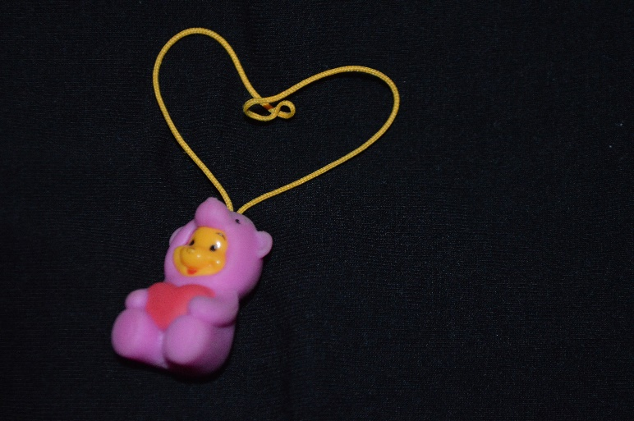
The Tragedy of Romeo and Juliet By: William Shakespeare
I won’t give up:
“’Cause I won’t give up on us, even if the skies get rough”
-Jason Mraz
Hold Onto Love<3
-Samantha Holmes

Slide 16
The Tragedy of Romeo and Juliet By: William Shakespeare
As many people, a loved one leaving you can be very hard. This is something that is learned in Romeo and Juliet. Romeo refuses to leave his true love-Juliet, which is represented by the song I wont give up, because it describes a person who refuses to give up on their relationship. The picture also resembles this theme because it features Pooh bear clutching a heart, as if it would shatter if he let go. Love is a very powerful emotion and it can, and often times will, change the course of a persons life.

Slide 17
To Kill a Mockingbird By: Harper Lee
The way people stereotype others create social barriers. One of these barriers is racism, which can cause whole ethnic groups to suffer under societies discriminatory hand. In To Kill a Mockingbird, by Harper Lee takes a deeper look into this issue.
In the United States, people should not, “believe in persecuting anybody,” because, “Persecution comes from people who are prejudiced” (Lee 245).

Slide 18
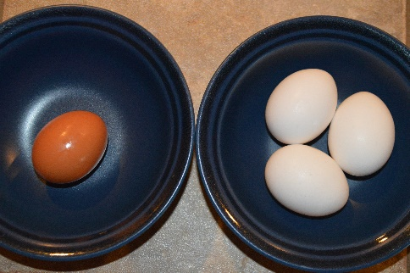
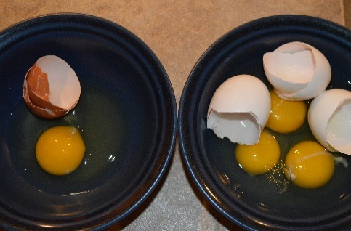
To Kill a Mockingbird By: Harper Lee
Societies child
“Preachers of equality. They say, “believe us”, but why don’t they just let us be?”
-Janis Ian
We’re all really the same:
-Samantha Holmes

Slide 19
To Kill a Mockingbird By: Harper Lee
Racism affects many people all over the world. And as the song, Societies Child, tells us, people preach and teach about equality, but then they do not apply that concept to their own daily lives. As the picture shows, we are all really the same on the inside. But, as we learn from To Kill a Mockingbird, people still have a hard time accepting that people may look different from one another. This is racism, and this is a problem that needs to be fixed.

